Slide 1
TESTING
What is Testing and why to use Testing?
Types of testing.
Automation Testing and why to use it?
Automation Testing advantages and Tools.
What is Selenium?
Features/Advantages and how to work with Selenium.
Explanation of Selenium IDE.
How to record and playback using selenium ?
Checkpoints in selenium and why to use them ?
By : Harshvardhan Upadhyaya
800229

Slide 2
Why Testing ?
What is Testing ?
Testing is the process of identifying defects, where a defect is any variance between actual and expected result.
Software testing is any activity aimed at evaluating an attribute or capability of a program or system and determining that it meets its required results.
Software testing is a trade-off between budget, time and quality.
Functionality (exterior quality) | Engineering (interior quality) | Adaptability (future quality)
Correctness | Efficiency | Flexibility
Reliability | Testability | Reusability
Usability | Documentation | Maintainability
Integrity | Structure

Slide 3
TYPES OF TESTING
Black box testing–
White box testing –
Unit testing –
Incremental integration testing –
Integration testing –
Functional testing –
System testing –
End-to-end testing –
Sanity testing -
Regression testing –
Acceptance testing -
Load testing –
Stress testing –
Performance testing –
Usability testing –
Install/uninstall testing -
Recovery testing –
Security testing –
Compatibility testing –
Comparison testing –
Alpha testing –
Beta testing –

Slide 4
Automation Testing
Test automation is the use of software to control the execution of tests, the comparison of actual outcomes to predicted outcomes, the setting up of test preconditions, and other test control and test reporting functions.
Why Automated Testing?
Manual Testing is performed by a human sitting in front of a computer carefully going through application screens, trying various usage and input combinations, comparing the results to the expected behavior and recording their observations. Manual tests are repeated often during development cycles for source code changes and other situations like multiple operating environments and hardware configurations. An automated tool is able to playback pre-recorded and predefined actions, compare the results to the expected behavior and report the success or failure of these manual tests to a test engineer. Once automated tests are created they can easily be repeated and they can be extended to perform tasks impossible with manual testing. Because of this, savvy managers have found that automated software testing is an essential component of successful development projects.

Slide 5
Advantages of Automation Tools Automated Software Testing Saves Time and Money. A time savings that translates directly into cost savings. Automated Software Testing Improves Accuracy. Automated Software Testing Increases Test Coverage Automated Software Testing Does What Manual Testing Cannot. Automated Software Testing Helps Developers and Testers. Automated Software Testing Improves Team Morale.

Slide 6
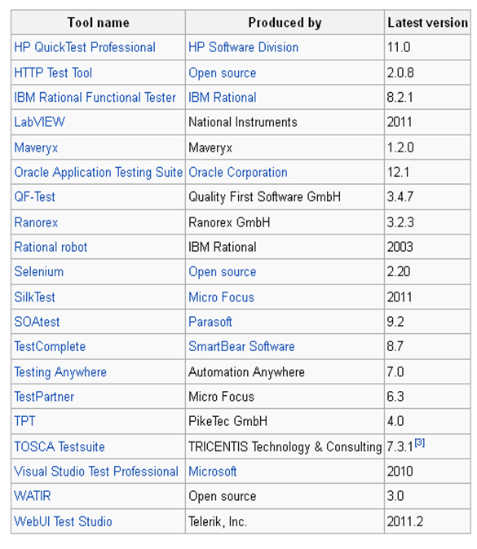
Types of Automation Tools

Slide 7

Selenium – Testing Tool

Slide 8
What is Selenium?
• Selenium is a robust set of tools that supports rapid development of test automation for web-based applications.
• Works anywhere JavaScript is supported
• Hooks for many other languages - Java, Ruby, Python
• Can simulate a user navigating through pages and then assert for specific marks on the pages
You can use open source - Selenium tool
Selenium IDE is a plug-in to Firefox to record and playback tests .
You can then export the recorded test in most language e.g. HTML, Java , .NET , Perl , Ruby etc.
The exported test can be run in any browser and any platform using "selenium remote control“ and webdriver.

Slide 9
Selenium IDE Features
Record and playback
Intelligent field selection will use IDs, names, or XPath as needed
Auto complete for all common Selenium commands
Walk through test cases and test suites.
Debug and set breakpoints
Save tests as HTML, Ruby scripts, or other formats
Support for Selenium user-extensions.js file
Option to automatically assert the title of every page
Rollup common commands

Slide 10
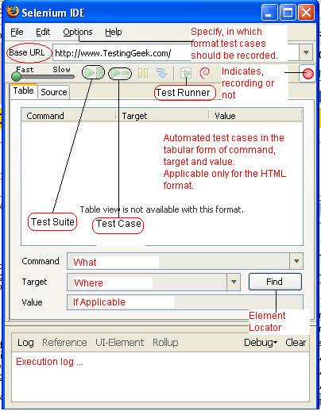
Explanation of the IDE

Slide 11
SAMPLE DEMOS
TO RECORD AND PLAYBACK(3)
ASSERTIONS
VERFICATIONS
SYNCHRONIZATIONS

Slide 12
Thanks
Questions ?

